Slide 1
OPER 618 Lesson 11 Bilevel Programming and MPECs
Dr. Brian J. Lunday
Office: Rm 201E, Bldg 641

Slide 2
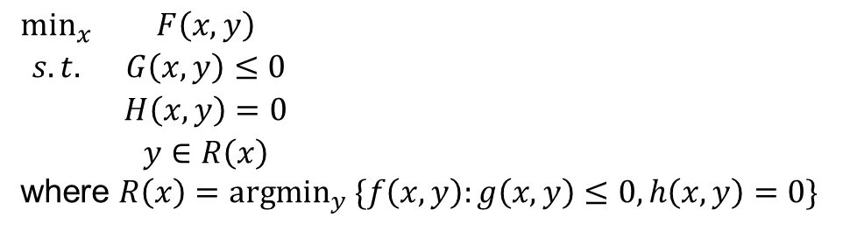
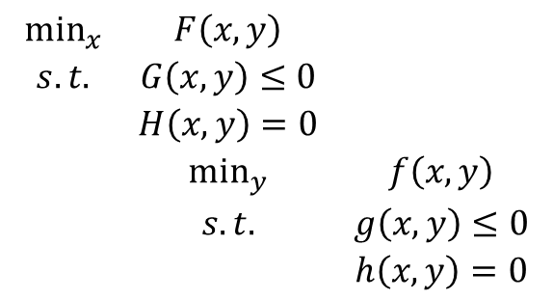
Bilevel Programming Problem Formulation Representations
A widely-accepted convention
$$\begin{matrix}\min_{x} & F\left(x,y\right) & \\ s.t. & G\left(x,y\right)≤0 & \\ & H\left(x,y\right)=0 & \\ & \min_{y} & f\left(x,y\right) \\ & s.t. & g\left(x,y\right)≤0 \\ & & h\left(x,y\right)=0\end{matrix}$$
A more rigorous, well-accepted convention
$\begin{matrix}\min_{x} & F\left(x,y\right) \\ s.t. & G\left(x,y\right)≤0 \\ & H\left(x,y\right)=0 \\ & y∈R\left(x\right)\end{matrix}$
where $R\left(x\right)=argmin_{y} \{f\left(x,y\right):g\left(x,y\right)≤0,h\left(x,y\right)=0\}$

Slide 3
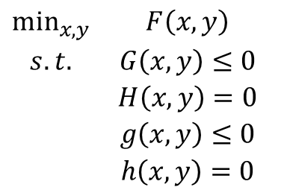
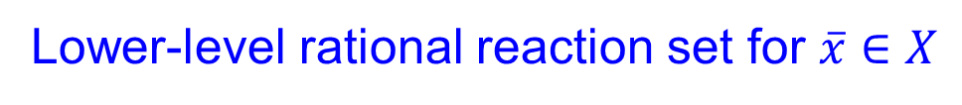
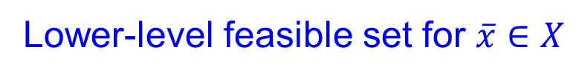
Key BLPP Terminology
BLPP Formulation Relaxation
$\begin{matrix}\min_{x,y} & F\left(x,y\right) \\ s.t. & G\left(x,y\right)≤0 \\ & H\left(x,y\right)=0 \\ & g\left(x,y\right)≤0 \\ & h\left(x,y\right)=0\end{matrix}$
Relaxed Feasible Region
$Ω=\left\{\left(x,y\right)∈ℝ^{n_{1}}×ℝ^{n_{2}}:G\left(x,y\right)≤0,H\left(x,y\right)=0,g\left(x,y\right)≤0,h\left(x,y\right)=0\right\}$
Lower-level feasible set for $\overline{x}∈X$
$Ω\left(\overline{x}\right)=\left\{y∈ℝ^{n_{2}}:g\left(\overline{x},y\right)≤0,h\left(\overline{x},y\right)=0 \right\}$
Lower-level rational reaction set for $\overline{x}∈X$
$R\left(\overline{x}\right)=\left\{y∈ℝ^{n_{2}}:y∈argmin \left\{f\left(\overline{x},\hat{y}\right),\hat{y}∈Ω\left(\overline{x}\right)\right\}\right\}$
Inducible Region
$$IR=\left\{\left(x,y\right)∈ℝ^{n_{1}}×ℝ^{n_{2}}:G\left(x,y\right)≤0,H\left(x,y\right)=0,y∈R(x)\right\}$$

Slide 4
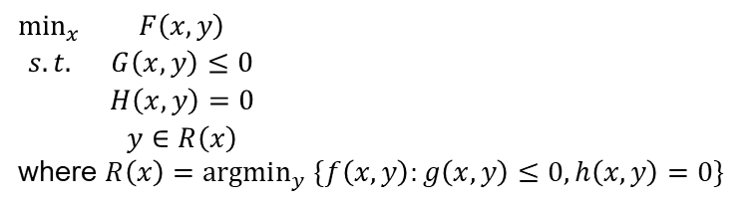
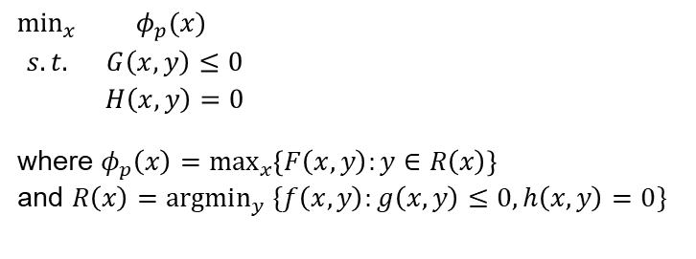
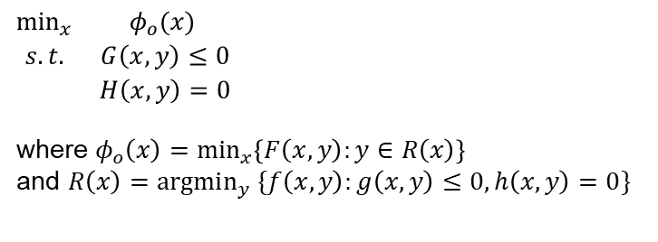
Optimistic and Pessimistic BLPP Solution Formulations
BLPP Formulation
$\begin{matrix}\min_{x} & F\left(x,y\right) \\ s.t. & G\left(x,y\right)≤0 \\ & H\left(x,y\right)=0 \\ & y∈R\left(x\right)\end{matrix}$
where $R\left(x\right)=argmin_{y} \{f\left(x,y\right):g\left(x,y\right)≤0,h\left(x,y\right)=0\}$
What if there are alternative optimal solutions for the follower’s problem?
Which solution will the follower chose?
The leader would surely have a preference.
Optimistic/weak Formulation
Pessimistic/strong Formulation
$\begin{matrix}\min_{x} & φ_{o}(x) \\ s.t. & G\left(x,y\right)≤0 \\ & H\left(x,y\right)=0 \\ & \end{matrix}$
where $φ_{o}\left(x\right)=\min_{x}\left\{F\left(x,y\right):y∈R\left(x\right)\right\}$
and $R\left(x\right)=argmin_{y} \{f\left(x,y\right):g\left(x,y\right)≤0,h\left(x,y\right)=0\}$
$\begin{matrix}\min_{x} & φ_{p}(x) \\ s.t. & G\left(x,y\right)≤0 \\ & H\left(x,y\right)=0 \\ & \end{matrix}$
where $φ_{p}\left(x\right)=\max_{x}\left\{F\left(x,y\right):y∈R\left(x\right)\right\}$
and $R\left(x\right)=argmin_{y} \{f\left(x,y\right):g\left(x,y\right)≤0,h\left(x,y\right)=0\}$
$φ_{o}(x)$ and $φ_{p}(x)$ are in general discontinuous, non-differentiable and nonconvex

Slide 5
Applications
What applications were of greatest interest to you from Sections 1 & 2?
What are some BLPP applications the authors did not discuss?

Slide 6
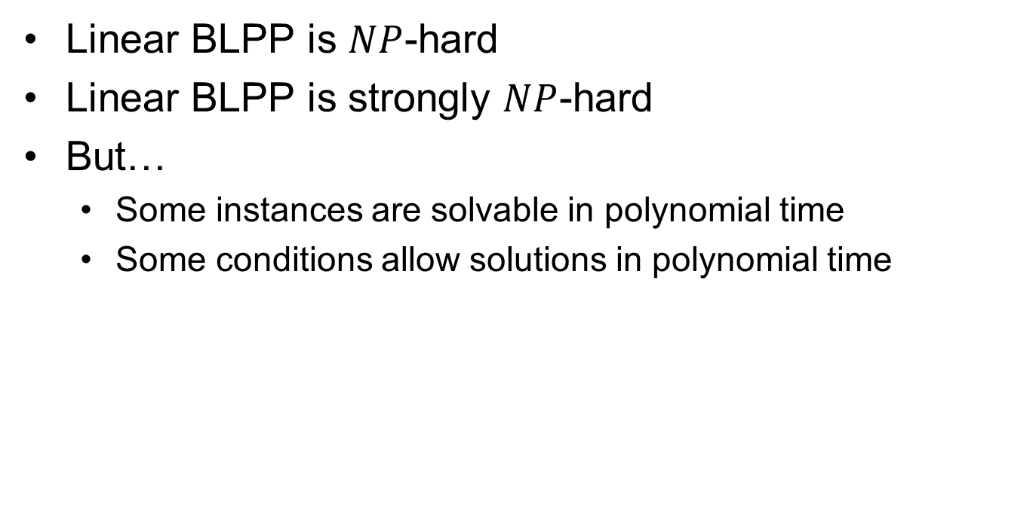
BLPP Complexity
Linear BLPP is $NP$-hard
Linear BLPP is strongly $NP$-hard
But…
Some instances are solvable in polynomial time
Some conditions allow solutions in polynomial time

Slide 7
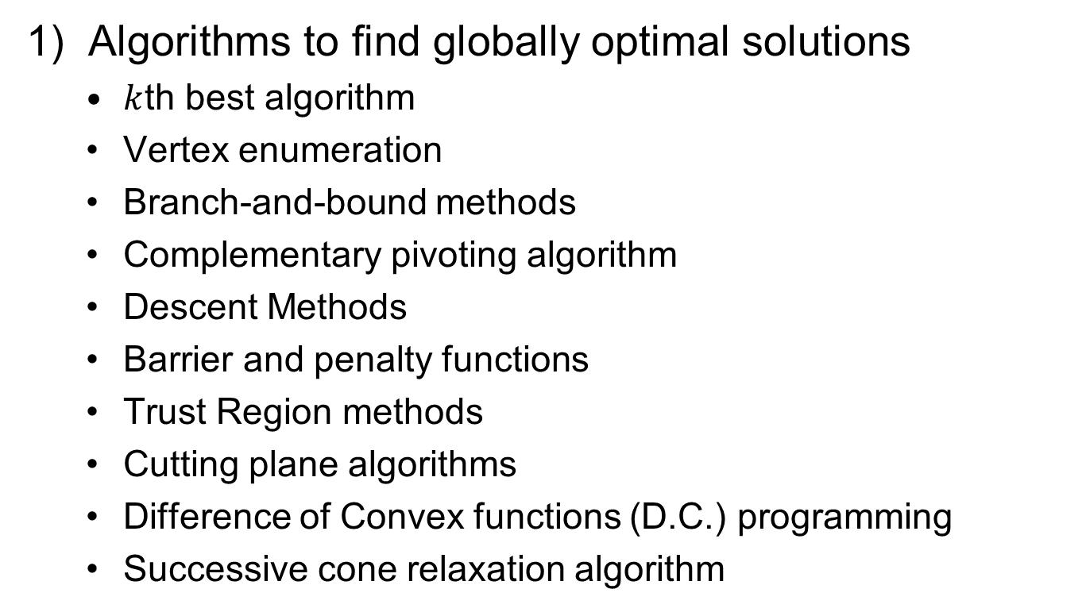
Solution Algorithms (1 of 2)
1) Algorithms to find globally optimal solutions
$k$th best algorithm
Vertex enumeration
Branch-and-bound methods
Complementary pivoting algorithm
Descent Methods
Barrier and penalty functions
Trust Region methods
Cutting plane algorithms
Difference of Convex functions (D.C.) programming
Successive cone relaxation algorithm

Slide 8
Solution Algorithms (2 of 2)
2) Methods to find locally optimal solutions
Stationarity concepts
Lipschhitz optimization to compute a Clarke stationary point
Bouligand stationarity
Algorithms – bundle, descent, interior point
3) Metaheuristics
Simulated annealing
Genetic algorithms
Others (ACO, PSO, etc.)

Slide 9
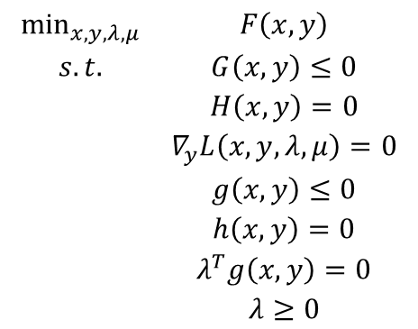
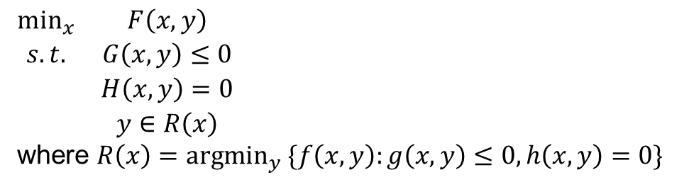
BLPPs and MPECs (1 of 2)
BLPP Formulation
$\begin{matrix}\min_{x} & F\left(x,y\right) \\ s.t. & G\left(x,y\right)≤0 \\ & H\left(x,y\right)=0 \\ & y∈R\left(x\right)\end{matrix}$
where $R\left(x\right)=argmin_{y} \{f\left(x,y\right):g\left(x,y\right)≤0,h\left(x,y\right)=0\}$
Lagrangian function of the follower’s problem
$$L\left(x,y,λ,μ\right)=f\left(x,y\right)+λ^{T}g\left(x,y\right)+μ^{T}h\left(x,y\right)$$
PENALIZE INFEASIBILITY
Single-level reformulation of BLPP
$$\begin{matrix}\min_{x,y,λ,μ} & F\left(x,y\right) \\ s.t. & G\left(x,y\right)≤0 \\ & H\left(x,y\right)=0 \\ & ∇_{y}L\left(x,y,λ,μ\right)=0 \\ & g\left(x,y\right)≤0 \\ & h\left(x,y\right)=0 \\ & λ^{T}g\left(x,y\right)=0 \\ & λ≥0\end{matrix}$$
STATIONARY POINT CRITERIA
PRIMAL FEASIBLE
KKT NECESSARY CONDITIONS
PRIMAL FEASIBLE
C.S. - RELEVANT IN S.P. CRITERIA IF NOT BINDING
DUAL FEASIBLE

Slide 10
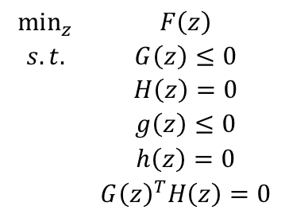
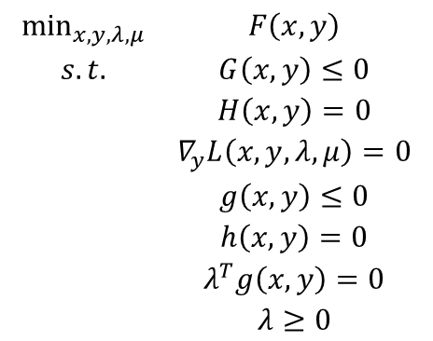
BLPPs and MPECs (2 of 2)
Single-level reformulation of BLPP
$$\begin{matrix}\min_{x,y,λ,μ} & F\left(x,y\right) \\ s.t. & G\left(x,y\right)≤0 \\ & H\left(x,y\right)=0 \\ & ∇_{y}L\left(x,y,λ,μ\right)=0 \\ & g\left(x,y\right)≤0 \\ & h\left(x,y\right)=0 \\ & λ^{T}g\left(x,y\right)=0 \\ & λ≥0\end{matrix}$$
Mathematical Program with Equilibrium Constraints (MPEC)
$$\begin{matrix}\min_{z} & F\left(z\right) \\ s.t. & G\left(z\right)≤0 \\ & H\left(z\right)=0 \\ & g\left(z\right)≤0 \\ & h\left(z\right)=0 \\ & G{\left(z\right)}^{T}H\left(z\right)=0\end{matrix}$$

Slide 11
Questions & Discussion

